Slide 1
Historical Data
A performance summary of DQN and A2C RL Agents

Slide 2
DQN Performance
Multi-Step Monthly Data

Slide 3
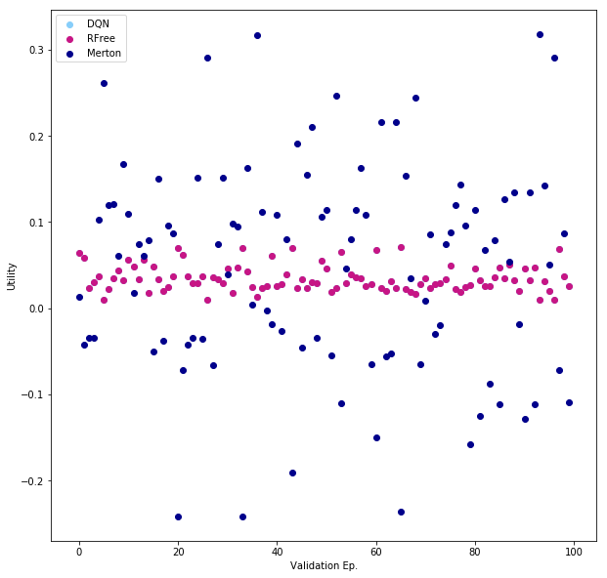
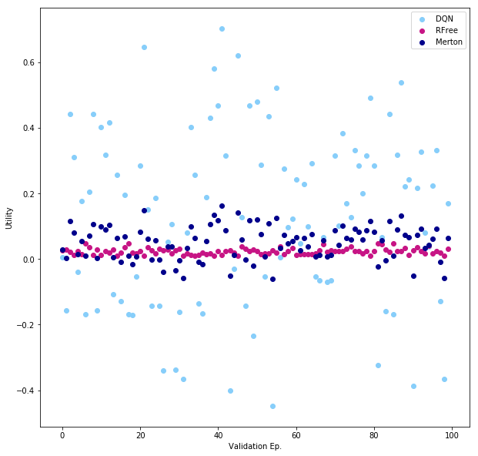
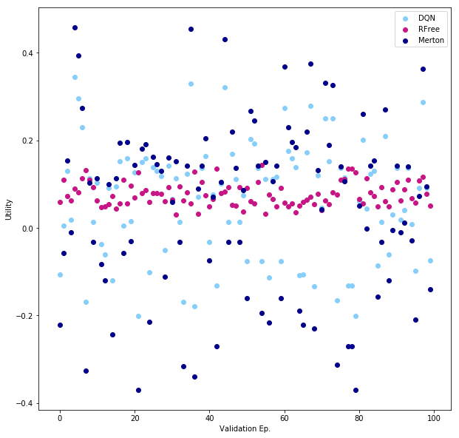
Trial I
# DQN Hyperparameters
"Learning Rate”. : 0.075
"Epoch" : 5
"Network Size" : [32, 16]
"Activation" : "Sigmoid"
"Alpha" : 0.015
"Batch Size" : 2048
"Action Dim" : 11
"Retrain Frequency" : 16 # Episode(s)
"Gamma" : 0.9992
# Environment Settings
”Risk Aversion" : 1
"Episode Length" : 12
"Max/Min Leverage" : +-5
"Validation Frac" : 0.3
"Time Step" : Monthly
"Number Eps" : 1000
 | Graph One |  | Graph Two |  | Graph Three
 | Mean Utility | Std | Mean Utility | Std | Mean Utility | Std
DQN | 0.0346 | 0.0151 | 0.1263 | 0.2637 | 0.0642 | 0.1302
Risk Free | 0.0346 | 0.0151 | 0.0238 | 0.0096 | 0.0771 | 0.0267
Merton | 0.0480 | 0.1213 | 0.0500 | 0.0510 | 0.0484 | 0.1990
Notes:
The performance varies dramatically between subsequent iterations of the algorithm, which is expected after so few episodes of training.
However 1000 eps is already 24x the amount of data in the training set (551 steps)

Slide 4
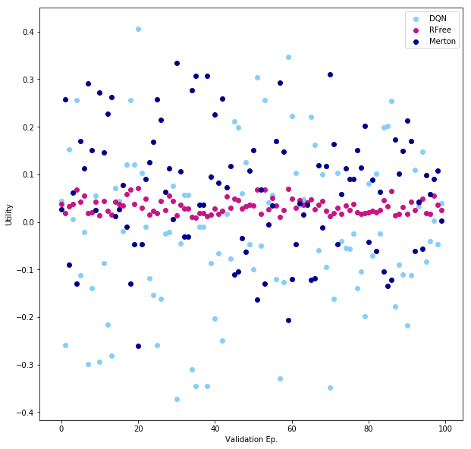
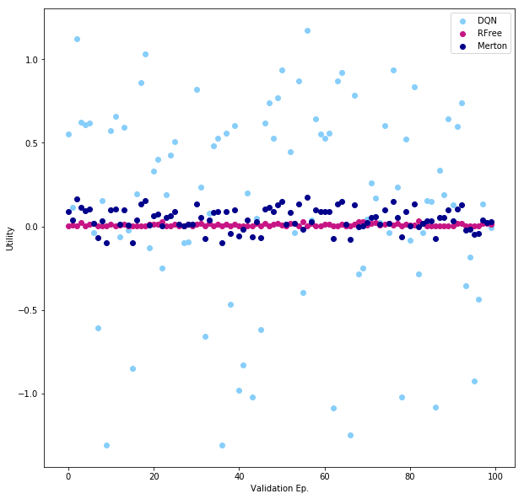
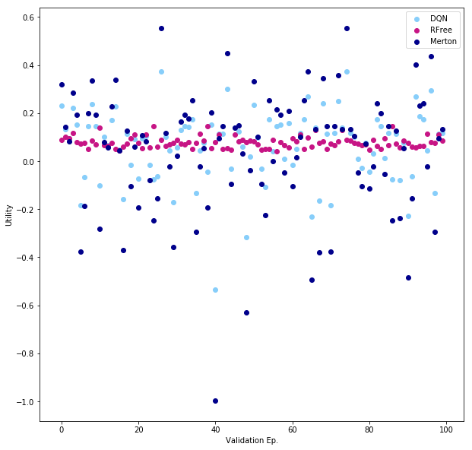
Trial II
# DQN Hyperparameters
"Learning Rate”. : 0.075
"Epoch" : 5
"Network Size" : [32, 16]
"Activation" : "Sigmoid"
"Alpha" : 0.015
"Batch Size" : 2048
"Action Dim" : 11
"Retrain Frequency" : 16 # Episode(s)
"Gamma" : 0.9992
# Environment Settings
”Risk Aversion" : 1
"Episode Length" : 12
"Max/Min Leverage" : +-5
"Validation Frac" : 0.3
"Time Step" : Monthly
"Number Eps" : 10000
 | Graph One |  | Graph Two |  | Graph Three
 | Mean Utility | Std | Mean Utility | Std | Mean Utility | Std
DQN | -0.0199 | 0.1658 | 0.1373 | 0.5826 | 0.0646 | 0.1454
Risk Free | 0.0327 | 0.0156 | 0.0093 | 0.0076 | 0.0787 | 0.0234
Merton | 0.0671 | 0.1294 | 0.0438 | 0.0668 | 0.0394 | 0.2529
Notes:
Now the data is being oversampled by a few hundred times, the effect should be similar to fitting to a small amount of data over many hundred epochs.
Overfitting is potentially a problem here, except that the hyper parameters were trained in the simulated env.

Slide 5
Actor Critic Performance
Multi-Step Monthly Data

Slide 6
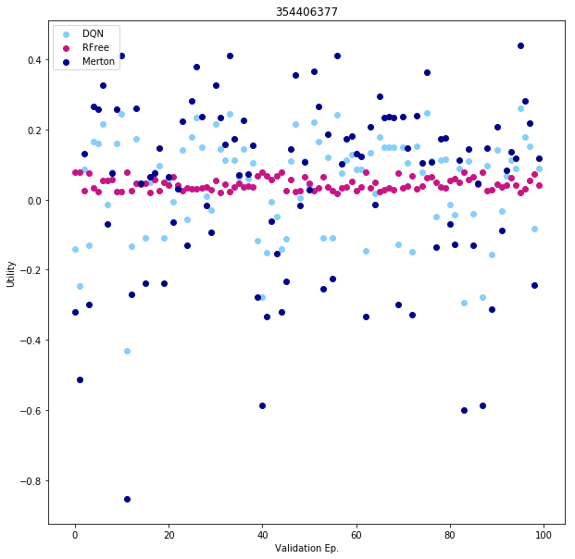
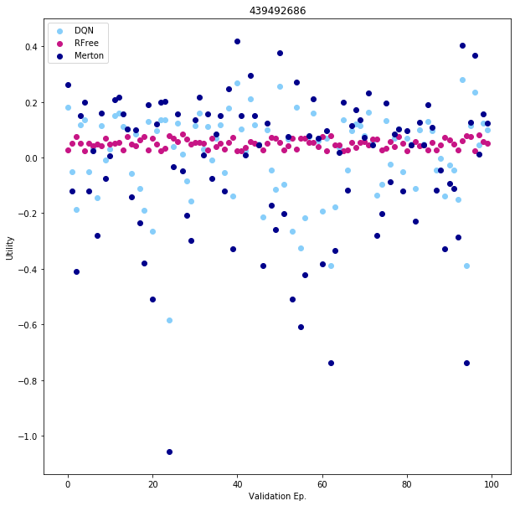
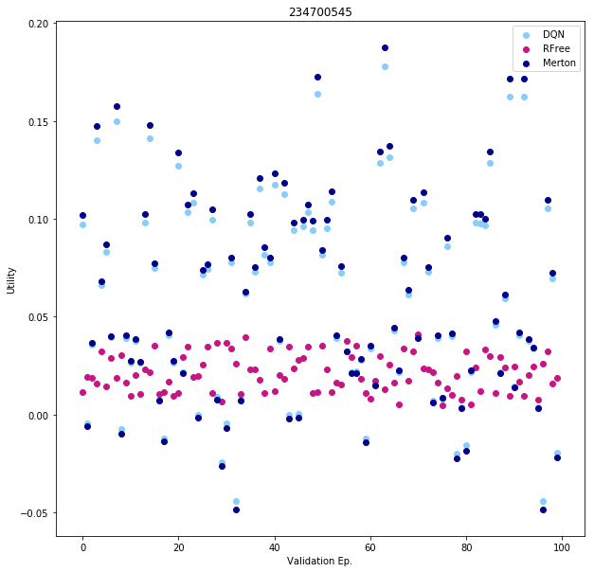
Trial I
# Actor Hyperparameters
"Learning Rate”. : 0.075
"Epoch" : 1
"Network Size" : [4, 4]
"Activation" : "Sigmoid"
"Alpha" : 0.10
# Critic Hyperparameters
"Learning Rate”. : 0.05
"Epoch" : 10
"Network Size" : [4, 4]
"Activation" : "Sigmoid"
"Alpha" : 0.001
"Retrain Frequency" : 16
# Environment Settings
”Risk Aversion" : 1
"Episode Length" : 12
"Max/Min Leverage" : +-750
"Validation Frac" : 0.3
"Time Step" : Monthly
"Number Eps" : 10000
 | Graph One |  | Graph Two |  | Graph Three
 | Mean Utility | Std | Mean Utility | Std | Mean Utility | Std
Actor Critic | 0.0465 | 0.1366 | 0.0151 | 0.1516 | 0.0585 | 0.0505
Risk Free | 0.0443 | 0.0177 | 0.0502 | 0.0169 | 0.0211 | 0.0094
Merton | 0.0388 | 0.2550 | -0.0233 | 0.2618 | 0.0606 | 0.0535
Notes:
The Actor Critic is able to learn the Merton portfolio fraction much faster than the DQN, as seen in the simulated environment. This is presumably due to the smaller networks required for AC vs DQN.
The correlation between AC solution and the Merton solution suggests that the agent found little use in the other state parameters.

Slide 7
DQN Performance
Multi-Step Daily Data
Moving to daily data requires the use of larger episodes, as otherwise the effect of an action is too negligible to be picked up by the network, as was determined in the simulated environment. However using longer episodes reduces the reward to step ratio (which represents the density of information being passed back to the agent) and hence harms convergence. Thus intermediate reward is important in the daily version of this environment.

Slide 8
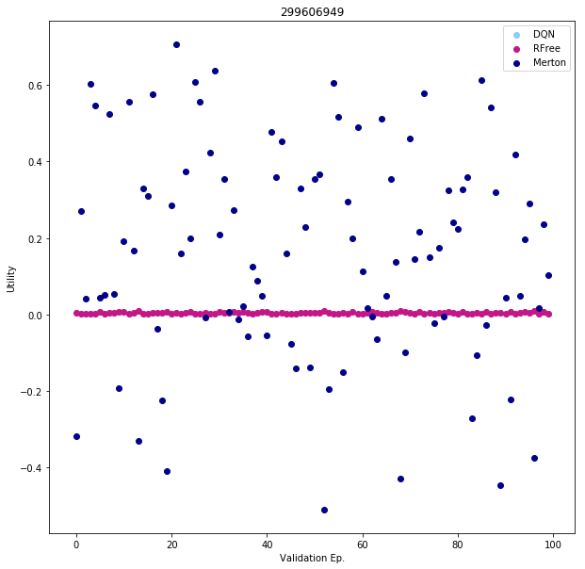
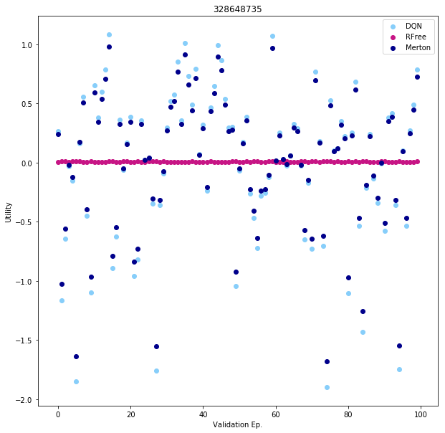
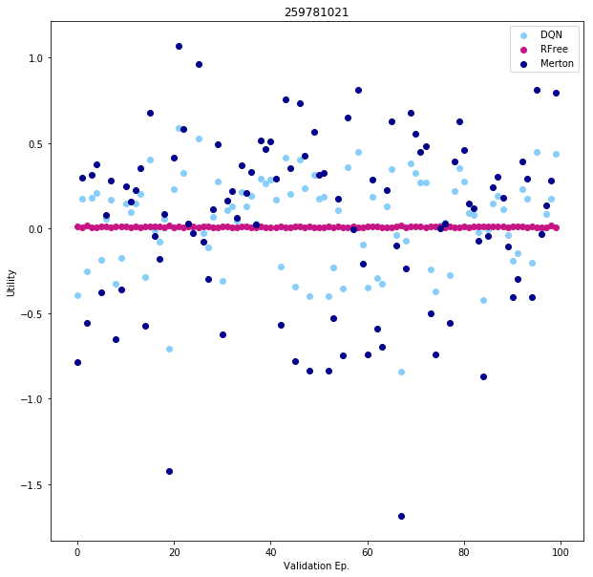
Trial I
# DQN Hyperparameters
"Learning Rate”. : 0.075
"Epoch" : 5
"Network Size" : [32, 16]
"Activation" : "Sigmoid"
"Alpha" : 0.015
"Batch Size" : 2048
"Action Dim" : 11
"Retrain Frequency" : 2 # Episode(s)
"Gamma" : 0.9992
# Environment Settings
”Risk Aversion" : 1
"Episode Length" : 252
"Max/Min Leverage" : +-5
"Validation Frac" : 0.3
"Time Step" : Daily
"Number Eps" : 1000
 | Graph One |  | Graph Two |  | Graph Three
 | Mean Utility | Std | Mean Utility | Std | Mean Utility | Std
DQN | 0.0039 | 0.0018 | -0.0158 | 0.6514 | 0.0468 | 0.2664
Risk Free | 0.0039 | 0.0018 | 0.007 | 0.0028 | 0.0078 | 0.0028
Merton | 0.1644 | 0.2786 | -0.0054 | 0.5803 | 0.0485 | 0.5151
Notes:
In the first instance the DQN learnt to hold only the risk free asset, and the subsequent instances it learnt variations of the Merton fraction, almost perfectly appraising it in the second instance.
Shows little dependency upon the other state parameters which presumably are in flux across the validation dataset.

Slide 9
Actor Critic Performance
Multi-Step Daily Data

Slide 10
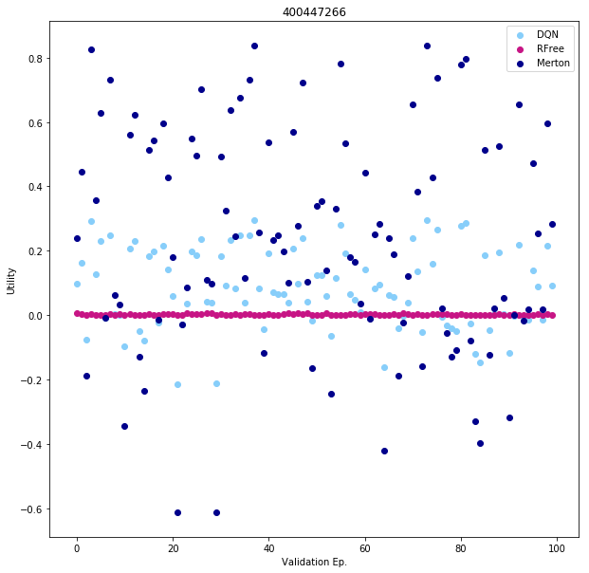
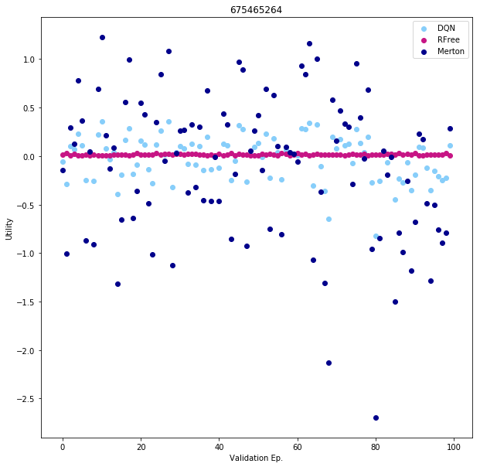
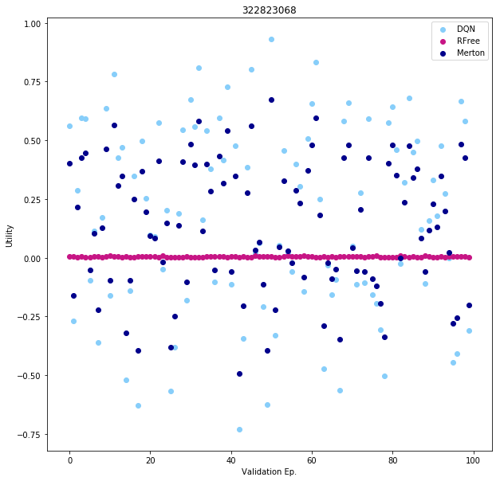
Trial I
# Actor Hyperparameters
"Learning Rate”. : 0.075
"Epoch" : 1
"Network Size" : [4, 4]
"Activation" : "Sigmoid"
"Alpha" : 0.10
# Critic Hyperparameters
"Learning Rate”. : 0.05
"Epoch" : 10
"Network Size" : [4, 4]
"Activation" : "Sigmoid"
"Alpha" : 0.001
"Retrain Frequency" : 2
# Environment Settings
”Risk Aversion" : 1
"Episode Length" : 252
"Max/Min Leverage" : +-750
"Validation Frac" : 0.3
"Time Step" : Daily
"Number Eps" : 1000
 | Graph One |  | Graph Two |  | Graph Three
 | Mean Utility | Std | Mean Utility | Std | Mean Utility | Std
Actor Critic | 0.0814 | 0.1224 | -0.0194 | 0.2212 | 0.1702 | 0.4018
Risk Free | 0.0019 | 0.0016 | 0.0156 | 0.0059 | 0.0044 | 0.0021
Merton | 0.2349 | 0.3439 | -0.1051 | 0.7353 | 0.1365 | 0.2774
Notes:
In the daily setting the Actor Critic is no longer able to mimic the Merton fraction as well as it did with monthly data.
Perhaps it believes other state parameters have more predictive power on a daily basis (however its performance is not consistently stellar out of sample so we cannot conclude it is beating Merton)

